Slide 1
Conceptual Modeling
CSIT882: Data Management Systems
Notes:
<!-- Neural, Brian, Male, British English. -->
<speak>
<break time="0.5s"/>
<prosody rate="90%">
Conceptual modeling.
<break time="0.3s"/>
This presentation explains a methodology, that will be used for conceptual modeling.
<break time="0.5s"/>
</prosody>
</speak>
1
Systems Analysis

Slide 2
Outline
Methodology
Example 1
Example 2
Example 3
Example 4
2
Notes:
<!-- Neural, Brian, Male, British English. -->
<speak>
<break time="0.5s"/>
<prosody rate="90%">
Methodology.
<break time="0.5s"/>
</prosody>
</speak>
Systems Analysis
2

Slide 3
Methodology
Input: Specification of the requirements (usually a natural language description of a database domain)
Tools: Object Modeling graphical notation
Methods: Systematic transformation of individual components of specification of requirements into the components of Object Modeling notation
Output: Conceptual schema - simplified object class diagram
3
Notes:
<!-- Neural, Brian, Male, British English. -->
<speak>
<break time="0.5s"/>
<prosody rate="90%">
A conceptual modeling methodology used in this subject, transforms a specification of database domain, into a conceptual schema expressed in a graphical notation of object modeling.
<break time="0.3s"/>
A transformation is performed in several steps.
<break time="0.3s"/>
In each step a specification of database domain is traversed and the new components, like classes of objects, attributes, associations, are added to a conceptual schema.
<break time="0.3s"/>
In each step, a conceptual schema is extended by only one type of component.
<break time="0.3s"/>
A transformation is consistent with a principle "one step at a time", that according to the Cambridge Dictionary means, doing things slowly and carefully, doing just a little at a time.
<break time="0.3s"/>
At the end of the process, we obtain a complete conceptual schema expressed as a simplified object class diagram.
<break time="0.5s"/>
</prosody>
</speak>
Systems Analysis
3

Slide 4
Methodology
The transformations of a specification of database domain are performed in the following sequence of steps:
Step 1: Creating classes of objects
Step 2: Creating associations and association classes
Step 3: Creating attributes and link attributes
Step 4: Creating identifiers
Step 5: Creating qualifications
Step 6: Creating generalizations
4
Notes:
<!-- Neural, Brian, Male, British English. -->
<speak>
<break time="0.5s"/>
<prosody rate="90%">
A sequence of transformations of a specification of database domain, is performed in the following way.
<break time="0.3s"/>
First, we read a specification, we identify the classes of objects and we create an initial conceptual schema, that contains only the classes of objects.
<break time="0.3s"/>
Then, we read a specification again, and we add to a conceptual schema the associations and association classes.
<break time="0.3s"/>
Next, we read a specification again, and we add to a conceptual schema the attributes and link attributes describing classes of objects and association classes.
<break time="0.3s"/>
Next, we read a specification again, and we add to a conceptual schema the identifiers of classes of objects.
<break time="0.3s"/>
At this step, we also identify the classes of objects, that do not have their own identification systems.
<break time="0.3s"/>
Next, we read a specification again, and we create the qualifications, that provide the identifiers for the classes, that do not have their own identification systems.
<break time="0.3s"/>
Finally, we read a specification again, oh, maybe there is no need to read it one more time, we probably memorised a specification thus far, and we add to a conceptual schema the generalization hierarchies.
<break time="0.5s"/>
</prosody>
</speak>
Systems Analysis
4

Slide 5
Outline
Methodology
Example 1
Example 2
Example 3
Example 4
5
Notes:
<!-- Neural, Brian, Male, British English. -->
<speak>
<break time="0.5s"/>
<prosody rate="90%">
Example one.
<break time="0.3s"/>
Employees and projects.
<break time="0.5s"/>
</prosody>
</speak>
Systems Analysis
5

Slide 6
Example 1
An objective is to create a conceptual schema of a small database that contains information about employees and projects
A detailed specification is the following:
- A group of employees works on the projects
- Some of employees supervise other employees
- Employees are described by their employee number and their full name
- A project is described by a project title, completion date and budget
- Employees are identified by their employee numbers and projects are identified by the titles
6
Notes:
<!-- Neural, Brian, Male, British English. -->
<speak>
<break time="0.5s"/>
<prosody rate="90%">
An objective is to create a conceptual schema, of a small database, that contains information about employees and projects.
<break time="0.3s"/>
A detailed specification is the following.
<break time="0.3s"/>
A group of employees works on the projects.
<break time="0.3s"/>
Some of employees supervise other employees.
<break time="0.3s"/>
Employees are described by their employee numbers and full names.
<break time="0.3s"/>
A project is described by a project title, completion date, and budget.
<break time="0.3s"/>
Employees are identified by their employee numbers and projects are identified by the titles.
<break time="0.3s"/>
</prosody>
</speak>
Systems Analysis
6

Slide 7
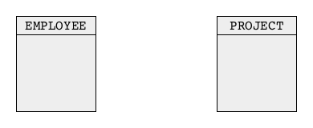
Example 1
Step 1: Creating classes of objects
A group of employees works on the projects. Some of employees supervise other employees. Employees are described by their employee numbers and full names. A project is described by a project title, completion date, and budget.
Employees are identified by the employee numbers and projects are identified by the titles
7
Notes:
<!-- Neural, Brian, Male, British English. -->
<speak>
<break time="0.5s"/>
<prosody rate="90%">
In the first step, we find the classes of objects, and we create the first version of conceptual schema, that contains only classes of objects.
<break time="0.3s"/>
To do so, we read a specification of a database domain, and find two classes of objects, employees and projects.
<break time="0.3s"/>
We create two new classes of objects, employee and project.
<break time="0.5s"/>
</prosody>
</speak>
Systems Analysis
7

Slide 8
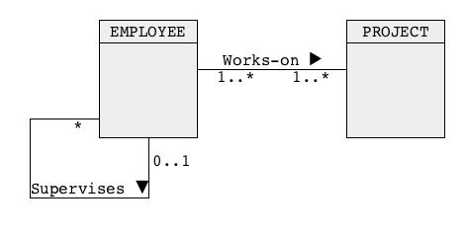
Example 1
Step 2: Creating associations and association classes
A group of employees works on the projects. Some of employees supervise other employees. Employees re described by their employee numbers and full names. A project is described by a project title, completion date, and budget. Employees are identified by the employee numbers and projects are identified by the titles
8
Notes:
<!-- Neural, Brian, Male, British English. -->
<speak>
<break time="0.5s"/>
<prosody rate="90%">
In the second step, we create, and we append to the conceptual schema, associations and association classes.
<break time="0.3s"/>
We find two associations: employee works on project, and employee supervises employee.
<break time="0.3s"/>
We append the associations to the conceptual schema.
<break time="0.3s"/>
An association employee works on project is many-to-many because an employee can work on many projects, and a project can be implemented by many employees.
<break time="0.3s"/>
We assume, that participation of both classes in the association is compulsory.
<break time="0.3s"/>
It means, that an employee must work on at least one projects, and a project must be implemented by at least one employee.
<break time="0.3s"/>
An association, employee supervises employee, is one-to-many, because an employee can supervise zero or more employees, and an employee has at the most one manager.
<break time="0.3s"/>
The topmost manager does not have a supervisor, and because of that multiplicity on one side of association is 0 dot dot 1.
<break time="0.5s"/>
</prosody>
</speak>
Systems Analysis
8

Slide 9
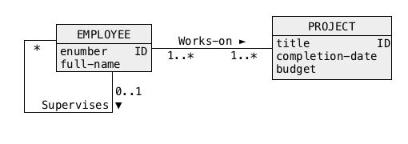
Example 1
Step 3: Creating attributes and link attributes
A group of employees works on the projects. Some of employees supervise other employees. Employees are described by their employee numbers and full names. A project is described by a project title, completion date and budget.
Employees are identified by the employee numbers and projects are identified by the titles.
9
Notes:
<!-- Neural, Brian, Male, British English. -->
<speak>
<break time="0.5s"/>
<prosody rate="90%">
In the third step, we find and we create attributes and link attributes.
<break time="0.3s"/>
We find, that employees are described by their employee numbers and full names.
<break time="0.3s"/>
We add both attributes to a description of the class employee.
<break time="0.3s"/>
We also find, that a project is described by a project title, completion date, and budget.
<break time="0.3s"/>
We add three attributes, project title, completion date, and budget, to a description of the class project.
<break time="0.5s"/>
</prosody>
</speak>
Systems Analysis
9

Slide 10
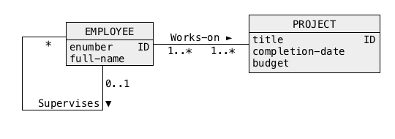
Example 1
Step 4: Creating identifiers
A group of employees works on the projects. Some of employees supervise other employees. Employees are described by their employee numbers and full names. A project is described by a project title, completion date and budget.
Employees are identified by the employee numbers and projects are identified by the titles
10
Notes:
<!-- Neural, Brian, Male, British English. -->
<speak>
<break time="0.5s"/>
<prosody rate="90%">
In the fourth step, we find identifiers, and we mark identifiers in a conceptual schema, with I D tags.
<break time="0.3s"/>
We find, that employees are identified by their employee numbers, and we add a tag, I D to an attribute e number in a class employee.
<break time="0.3s"/>
We find, that projects are identified by the titles, and we add a tag, I D to an attribute title in a class project.
<break time="0.5s"/>
</prosody>
</speak>
Systems Analysis
10

Slide 11
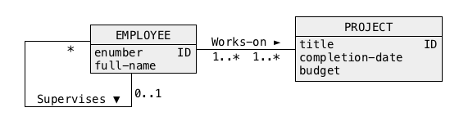
Example 1
Step 5: Creating qualifications
A group of employees works on the projects. Some of employees supervise other employees. Employees are described by their employee numbers and full names. A project is described by a project title, completion date, and budget.
Employees are identified by the employee numbers and projects are identified by the titles
11
Notes:
<!-- Neural, Brian, Male, British English. -->
<speak>
<break time="0.5s"/>
<prosody rate="90%">
Next, we try to find qualifications.
<break time="0.3s"/>
A specification does not contain any information about qualifications.
<break time="0.5s"/>
</prosody>
</speak>
Systems Analysis
11

Slide 12
Example 1
Step 6: Creating generalisations
A group of employees works on the projects. Some of employees supervise other employees. Employees are described by their employee numbers and full names. A project is described by a project title, completion date, and budget.
Employees are identified by the employee numbers and projects are identified by the titles
12
Notes:
<!-- Neural, Brian, Male, British English. -->
<speak>
<break time="0.5s"/>
<prosody rate="90%">
Finally, in the last step, we look for generalisation hierarchies.
<break time="0.3s"/>
A sample database domain does not contain any information, about subsets or supersets of objects.
<break time="0.3s"/>
Therefore, we conclude, that there are no generalisation hierarchies in the conceptual schema.
<break time="0.3s"/>
The final conceptual schema is visible at the bottom of a slide.
<break time="0.5s"/>
</prosody>
</speak>
Systems Analysis
12

Slide 13
Outline
Methodology
Example 1
Example 2
Example 3
Example 4
13
Notes:
<!-- Neural, Brian, Male, British English. -->
<speak>
<break time="0.5s"/>
<prosody rate="90%">
Example two.
<break time="0.3s"/>
Publications and authors.
<break time="0.5s"/>
</prosody>
</speak>
Systems Analysis
13

Slide 14
Example 2
An objective is to create a conceptual schema of a small database that contains information about publications such as journals and conference proceedings, published research papers and authors
A detailed specification is the following:
- A publishing company publishes the journals and conference proceedings
- The research papers are included in the journals and proceedings
- The company employs the general editors who take responsibility for editing research papers
- A research paper is written by one or more authors
14
Notes:
<!-- Neural, Brian, Male, British English. -->
<speak>
<break time="0.5s"/>
<prosody rate="90%">
An objective is to create a conceptual schema of a small database, that contains information about research publications, such as, journals and conference proceedings, and about published research papers and authors.
<break time="0.3s"/>
A detailed specification is the following:
<break time="0.3s"/>
Publishing company publishes the journals and conference proceedings.
<break time="0.3s"/>
The research papers are included in the journals and proceedings.
<break time="0.3s"/>
The company employs the general editors who take responsibility for editing the research papers.
<break time="0.3s"/>
A research paper is written by one or more authors.
<break time="0.5s"/>
</prosody>
</speak>
Systems Analysis
14

Slide 15
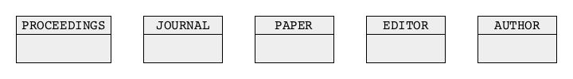
Example 2
Step 1: Creating classes of objects
A publishing company publishes journals and conference proceedings.
The research papers are included in journals and proceedings. The company employs the general editors who take responsibility for the editing research papers. A research paper is written by one or more authors.
15
Notes:
<!-- Neural, Brian, Male, British English. -->
<speak>
<break time="0.5s"/>
<prosody rate="90%">
In the first step, we create classes of objects, and we add classes of objects to an initial conceptual schema.
<break time="0.3s"/>
After reading and analysing a sample database domain, we decide to add to a conceptual schema the following classes of objects: proceedings, journal, paper, editor and author.
<break time="0.5s"/>
</prosody>
</speak>
Systems Analysis
15

Slide 16
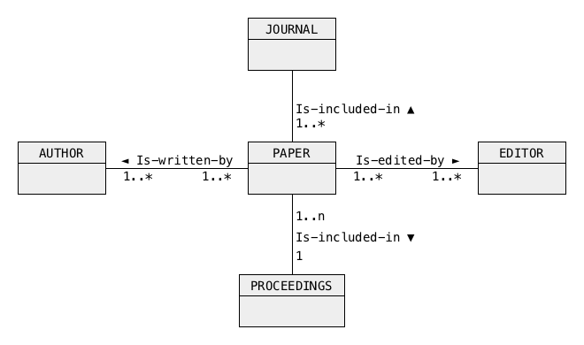
Example 2
Step 2: Creating associations and association classes
A publishing company publishes journals and conference proceedings.
The research papers are included in journals and proceedings. The company employs general editors who take responsibility for editing research papers. A research paper is written by one or more authors.
16
Notes:
<!-- Neural, Brian, Male, British English. -->
<speak>
<break time="0.5s"/>
<prosody rate="90%">
In the next step, we add to a conceptual schema, associations and association classes.
<break time="0.3s"/>
A statement: research papers are included in journals and proceedings contributes to the following associations: paper is included in journal, and paper is included in proceedings.
<break time="0.3s"/>
Due to the research integrity rules, a paper can be published only one time, and because of that both associations are one to many.
<break time="0.3s"/>
Of course, journals, proceedings publish many research papers.
<break time="0.3s"/>
A statement: the company employs the general editors, who take responsibility for the editing research papers, contributing to an association, paper is edited by editor.
<break time="0.3s"/>
An editor can edit many papers, and a paper can be edited by many editors.
<break time="0.3s"/>
Hence, an association, paper is edited by the editor, has a multiplicity many to many.
<break time="0.3s"/>
A statement: a research paper is written by one or more authors, contributes to an association, paper is written by author.
<break time="0.3s"/>
Such association has a multiplicity many to many, because a paper can be written by many authors, and an author can write many papers.
<break time="0.3s"/>
An updated conceptual schema is given at the bottom of a slide.
<break time="0.5s"/>
</prosody>
</speak>
Systems Analysis
16

Slide 17
Example 2
Step 3: Creating attributes and link attributes
A publishing company publishes journals and conference proceedings.
The research papers are included in journals and proceedings. The company employs general editors who take responsibility for editing research papers. A research paper is written by one or more authors.
17
Notes:
<!-- Neural, Brian, Male, British English. -->
<speak>
<break time="0.5s"/>
<prosody rate="90%">
In the next step, we are looking for, attributes, and link attributes.
<break time="0.3s"/>
After reading a specification we find, that a specification does not have any information, about attributes and links attributes.
<break time="0.3s"/>
In the reality, in such situation we have to return to our stakeholders, and ask the questions related to the descriptions of classes of objects and associations.
<break time="0.3s"/>
In our case, we progress to the next step.
<break time="0.5s"/>
</prosody>
</speak>
Systems Analysis
17

Slide 18
Example 2
Step 4: Creating identifiers
A publishing company publishes journals and conference proceedings.
The research papers are included in journals and proceedings. The company employs general editors who take responsibility for editing research papers. A research paper is written by one or more authors.
18
Notes:
<!-- Neural, Brian, Male, British English. -->
<speak>
<break time="0.5s"/>
<prosody rate="90%">
In the next step, we try to find identifiers of the classes of objects created so far.
<break time="0.3s"/>
After reading a specification again, we find, that it does not contain any information about identifiers.
<break time="0.3s"/>
This is why we skip this step as well.
<break time="0.5s"/>
</prosody>
</speak>
Systems Analysis
18

Slide 19
Example 2
Step 5: Creating qualifications
A publishing company publishes journals and conference proceedings.
The research papers are included in journals and proceedings. The company employs general editors who take responsibility for editing research papers. A research paper is written by one or more authors.
19
Notes:
<!-- Neural, Brian, Male, British English. -->
<speak>
<break time="0.5s"/>
<prosody rate="90%">
In this step we try to create qualifications.
<break time="0.3s"/>
Missing information about attributes and identifiers, creates a situation, where it is impossible to say anything about qualifications.
<break time="0.3s"/>
We move to the next step.
<break time="0.5s"/>
</prosody>
</speak>
Systems Analysis
19

Slide 20
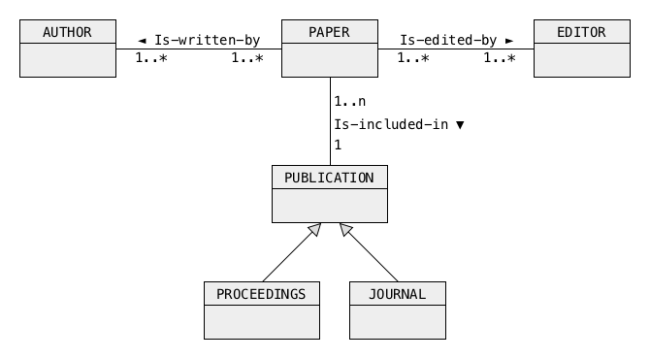
Example 2
Step 6: Creating generalisations
A publishing company publishes journals and conference proceedings.
The research papers are included in journals and proceedings. The company employs general editors who take responsibility for editing research papers. A research paper is written by one or more authors.
Journal, proceedings IS-A publication.
20
Notes:
<!-- Neural, Brian, Male, British English. -->
<speak>
<break time="0.5s"/>
<prosody rate="90%">
Finally, we are looking for the generalisation hierarchies.
<break time="0.3s"/>
To create a generalisation, we introduce a new concept of publication.
<break time="0.3s"/>
Both, proceedings, and journals are publications.
<break time="0.3s"/>
Therefore, we create a generalisation: the proceeding is a publication, and journal is a publication, see visualisation at the bottom of a conceptual schema.
<break time="0.3s"/>
Generalisation allows us to replace the associations, paper is included in proceeding, and paper is included in journal, with one association, paper is included in publication.
<break time="0.3s"/>
It is a commonly used solution to a problem, when many associations with the same names, link a class of objects with many other classes of objects, that can be generalised into a super class.
<break time="0.3s"/>
In such a case, generalisation to a super class, allows for elimination of the repetitions of the same associations.
<break time="0.3s"/>
In our case, it eliminates of the repetitions of an association: is included in.
<break time="0.5s"/>
</prosody>
</speak>
Systems Analysis
20

Slide 21
Outline
Methodology
Example 1
Example 2
Example 3
Example 4
21
Notes:
<!-- Neural, Brian, Male, British English. -->
<speak>
<break time="0.5s"/>
<prosody rate="90%">
Example three.
<break time="0.3s"/>
Construction companies and buildings.
<break time="0.5s"/>
</prosody>
</speak>
Systems Analysis
21

Slide 22
Example 3
An objective is to create a conceptual schema of a small database that contains information about the construction companies and buildings built by the companies
A detailed specification is the following:
- A group of construction companies is involved in the construction of industrial buildings
- A building is located at a different address, it has a unique name, and completion date
- A number of construction stages apply to each building
- A construction stage is described by its name, the names of the construction companies involved together with the start date, completion date and the total costs
- A construction company is usually involved in many construction stages of the same building
- Many construction companies are involved in one construction stage
22
Notes:
<!-- Neural, Brian, Male, British English. -->
<speak>
<break time="0.5s"/>
<prosody rate="90%">
An objective is to create a conceptual schema of a small database, that contains information about the construction companies, and about the buildings built by the construction companies.
<break time="0.3s"/>
A detailed specification is the following:
<break time="0.3s"/>
A group of construction companies is involved in construction of industrial buildings.
<break time="0.3s"/>
A building is located at a different address, it has a unique name, and completion date.
<break time="0.3s"/>
A number of construction stages apply to each building.
<break time="0.3s"/>
A construction stage is described by its name, the names of construction companies involved together with the start date, completion date, and the total costs.
<break time="0.3s"/>
A construction company is usually involved in many construction stages of the same building.
<break time="0.3s"/>
Many construction companies are involved in one construction stage.
<break time="0.5s"/>
</prosody>
</speak>
Systems Analysis
22

Slide 23
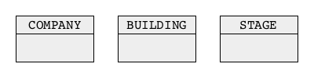
Example 3
Step 1: Creating classes of objects
A group of construction companies is involved in construction of industrial buildings. A building is located at a different address, it has a unique name and completion date. A number of construction stages apply to each building. A construction stage is described by its name, the names of construction companies involved together with the start date, completion date and the total costs. A construction company is usually involved in many construction stages of the same building. Many construction companies are involved in one construction stage.
23
Notes:
<!-- Neural, Brian, Male, British English. -->
<speak>
<break time="0.5s"/>
<prosody rate="90%">
In the first step, we read, and we analyse a database domain of companies and buildings, and we try to identify the classes of objects.
<break time="0.3s"/>
An outcome from the first step is a conceptual schema, that consists of three classes of objects: company, building and stage.
<break time="0.3s"/>
The facts, that lead to such collection of the classes of objects are the following.
<break time="0.3s"/>
A database is supposed to contain information, about a number of construction companies working on the industrial buildings.
<break time="0.3s"/>
A database is supposed to contain information, about the construction stages applied to the buildings, for example, excavations, laying foundations, concreting and the others.
<break time="0.5s"/>
</prosody>
</speak>
Systems Analysis
23

Slide 24
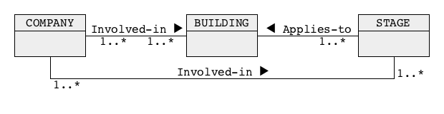
Example 3
Step 2: Creating associations and association classes
A group of construction companies is involved in construction of industrial buildings. A building is located at a different address, it has a unique name and completion date. A number of construction stages apply to each building. A construction stage is described by its name, the names of construction companies involved together with the start date, completion date and the total costs. A construction company is usually involved in many construction stages of the same building. Many construction companies are involved in one construction stage
24
Notes:
<!-- Neural, Brian, Male, British English. -->
<speak>
<break time="0.5s"/>
<prosody rate="90%">
In the next step, we read a specification again, and we try to find the associations, and association classes.
<break time="0.3s"/>
The facts like, construction companies involved in construction of industrial buildings, construction stages applied to buildings, and construction companies involved in many construction stages, contribute to the following associations.
<break time="0.3s"/>
Company involved in building.
<break time="0.3s"/>
The multiplicities on both sides of such association are many to many because a company is involved in construction of many buildings, and a building is constructed by many companies.
<break time="0.3s"/>
The next association is: stage applies to building.
<break time="0.3s"/>
A stage applies to one building and a building requires many construction stages.
<break time="0.3s"/>
Hence, the multiplicities are one to many from a building side.
<break time="0.3s"/>
The third association is: company involved in stage.
<break time="0.3s"/>
Such association is many to many, because a company is involved in many construction stages and a construction stage my need many companies.
<break time="0.3s"/>
Note, that the associations create a cycle in a conceptual schema.
<break time="0.3s"/>
Whenever, we get a cycle in a conceptual schema, we always try to eliminate it.
<break time="0.3s"/>
In our case, a conclusion, that if a company is involved in the construction stage, then such company is involved in construction of a building allows for elimination of a cycle.
<break time="0.3s"/>
We shall discuss it more thoroughly in the next slide.
<break time="0.5s"/>
</prosody>
</speak>
Systems Analysis
24

Slide 25
Example 3
Step 2 (improved): Creating associations and association classes
A group of construction companies is involved in construction of industrial buildings. A building is located at a different address, it has a unique name and completion date. A number of construction stages apply to each building. A construction stage is described by its name, the names of construction companies involved together with the start date, completion date and the total costs. A construction company is usually involved in many construction stages of the same building. Many construction companies are involved in one construction stage
If a company is involved in a construction stage that applies to a building then such company is involved in construction of the building
25
Notes:
<!-- Neural, Brian, Male, British English. -->
<speak>
<break time="0.5s"/>
<prosody rate="90%">
In this step we are still improving associations and association classes.
<break time="0.3s"/>
We realized, that if a company is involved in a construction stage applied to a building, then such company must be involved in the construction of a building.
<break time="0.3s"/>
It means, that association: company involved in building, is not really needed, because it can be logically derived from an association: company involved in construction stage.
<break time="0.3s"/>
Then, it is possible to eliminate a cycle of associations through elimination of one of the associations involved in the cycle.
<break time="0.3s"/>
Elimination of an association is possible, only if, such association can be logically derived from the other associations.
<break time="0.3s"/>
Sometimes, it is impossible to eliminate a cycle without loosing information.
<break time="0.3s"/>
For example, if we look at a database domain where sporting teams play their games, then the associations: team plays a home game, and, team plays an away game form a cycle, that involves both associations.
<break time="0.3s"/>
In such a case, it is impossible to break cycle, because we would loose information, who played a home game, or who played away game.
<break time="0.3s"/>
It means, that sometimes it is impossible to derive an association from the other association, in order to break a cycle.
<break time="0.5s"/>
</prosody>
</speak>
Systems Analysis
25

Slide 26
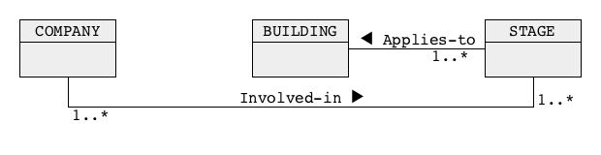
Example 3
Step 2 (improved): Creating associations and association classes
It means that we do not need an association Involved-in between the classes COMPANY and BUILDING because such association can be derived from the other two associations
26
Notes:
<!-- Neural, Brian, Male, British English. -->
<speak>
<break time="0.5s"/>
<prosody rate="90%">
We concluded, that an association: company involved in building, is not needed, because it can be logically derived from an association: company involved in construction stage.
<break time="0.3s"/>
We removed from a conceptual schema an association: company involved in building.
<break time="0.3s"/>
A conceptual schema after elimination of a redundant associatioon consists of two associations: company involved in stage, and, stage applies to building.
<break time="0.5s"/>
</prosody>
</speak>
Systems Analysis
26

Slide 27
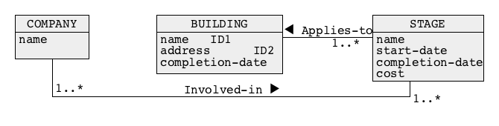
Example 3
Step 3: Creating attributes and link attributes
A group of construction companies is involved in construction of industrial buildings. A building is located at a different address, it has a unique name and completion date. A number of construction stages apply to each building. A construction stage is described by its name, the names of construction companies involved together with the start date, completion date and the total costs. A construction company is usually involved in many construction stages of the same building. Many construction companies are involved in one construction stage
27
Notes:
<!-- Neural, Brian, Male, British English. -->
<speak>
<break time="0.5s"/>
<prosody rate="90%">
In the next step, we find the attributes describing classes of objects, and link attributes, describing associations.
<break time="0.3s"/>
We read a description of a database domain again, and we find that a building is described by an address, name and the completion date.
<break time="0.3s"/>
We also find, that a construction stage is described by a name, start date, completion date and cost.
<break time="0.3s"/>
An information about construction stage being described by the names of construction companies, contributes to an attribute name describing a construction company.
<break time="0.3s"/>
We find no link attributes describing associations.
<break time="0.3s"/>
A conceptual schema with the attributes describing the classes of objects is given at the bottom of the slide.
<break time="0.3s"/>
</prosody>
</speak>
Systems Analysis
27

Slide 28
Example 3
Step 4: Creating identifiers
A group of construction companies is involved in construction of industrial buildings. A building is located at a different address, it has a unique name and completion date. A number of construction stages apply to each building. A construction stage is described by its name, the names of construction companies involved together with the start date, completion date and the total costs. A construction company is usually involved in many construction stages of the same building. Many construction companies are involved in one construction stage
We know that construction companies have unique names and the buildings have unique addresses.
28
Notes:
<!-- Neural, Brian, Male, British English. -->
<speak>
<break time="0.5s"/>
<prosody rate="90%">
In the next stage, we look at the attributes, to find the identifiers.
<break time="0.3s"/>
It is mentioned in the specification, that each building has a unique name.
<break time="0.3s"/>
Therefore, we nominate an attribute name as an identifier of a class: building.
<break time="0.3s"/>
We know from reality, that construction companies have unique names and the buildings have unique addresses.
<break time="0.3s"/>
It contributes to an identifier: name, for a class company and the second identifier: address, for a class building.
<break time="0.3s"/>
A class stage does not have its real world identification system.
<break time="0.3s"/>
Therefore, a qualification must be used to created an identifier for a class stage.
<break time="0.3s"/>
In the next step we use a qualification to create the identifiers for the classes that do not have their own real world identification systems.
<break time="0.5s"/>
</prosody>
</speak>
Systems Analysis
28

Slide 29
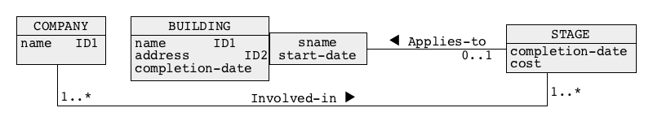
Example 3
Step 5: Creating qualifications
A group of construction companies is involved in construction of industrial buildings. A building is located at a different address, it has a unique name and completion date. A number of construction stages apply to each building. A construction stage is described by its name, the names of construction companies involved together with the start date, completion date and the total costs. A construction company is usually involved in many construction stages of the same building. Many construction companies are involved in one construction stage
We also know, that a construction stage of a building starts once at a given moment in time
29
Notes:
<!-- Neural, Brian, Male, British English. -->
<speak>
<break time="0.5s"/>
<prosody rate="90%">
In this step, we use the qualifications to create the identifiers.
<break time="0.3s"/>
We know from reality, that a construction stage of a building is performed in a given moment in time.
<break time="0.3s"/>
We also know, that a pair of attributes:, name of the construction stage and the start date, is a local identifier for a building.
<break time="0.3s"/>
Therefore, a triple of attributes, that consists of the building name, construction stage, and the date when the stage has been started, is a global identifier of a class construction stage.
<break time="0.3s"/>
Such identifier can be expressed by a qualification of a class: building and an association: applies to, with a pair of attributes: stage name, and start date.
<break time="0.5s"/>
</prosody>
</speak>
Systems Analysis
29

Slide 30
Example 3
Step 6: Creating generalisations
A group of construction companies is involved in construction of industrial buildings. A building is located at a different address, it has a unique name and completion date. A number of construction stages apply to each building. A construction stage is described by its name, the names of construction companies involved together with the start date, completion date and the total costs. A construction company is usually involved in many construction stages of the same building. Many construction companies are involved in one construction stage
30
Notes:
<!-- Neural, Brian, Male, British English. -->
<speak>
<break time="0.5s"/>
<prosody rate="90%">
In this step, we try to discover the generalisations.
<break time="0.3s"/>
One more pass through a text of specification, confirms, that the specification does not contain any information about generalizations over the classes of objects.
<break time="0.5s"/>
</prosody>
</speak>
Systems Analysis
30

Slide 31

Outline
Methodology
Example 1
Example 2
Example 3
Example 4
31
Notes:
<!-- Neural, Brian, Male, British English. -->
<speak>
<break time="0.5s"/>
<prosody rate="90%">
Example four.
<break time="0.5s"/>
</prosody>
</speak>
Systems Analysis
31

Slide 32
Example 4
An objective is to create a conceptual schema for a database domain described by the following poem for kids
"Caterpillar"
by Christina Rossetti
Brown and furry
Caterpillar in a hurry,
Take your walk
To the shady leaf, or stalk,
Or what not,
Which may be the chosen spot.
No toad spy you,
Hovering bird of prey pass by you;
Spin and die,
To live again a butterfly.
32
Notes:
<!-- Neural, Brian, Male, British English. -->
<speak>
<break time="0.5s"/>
<prosody rate="90%">
An objective is to create a conceptual schema, for a database domain, described by the following poem for kids.,
<break time="0.3s"/>
"Caterpillar".
<break time="0.3s"/>
by Christina Rossetti
<break time="0.3s"/>
Brown and furry
<break time="0.3s"/>
Caterpillar in a hurry,
<break time="0.3s"/>
Take your walk
<break time="0.3s"/>
To the shady leaf, or stalk,
<break time="0.3s"/>
Or what not,
<break time="0.3s"/>
Which may be the chosen spot.
<break time="0.3s"/>
No toad spy you,
<break time="0.3s"/>
Hovering bird of prey pass by you;
<break time="0.3s"/>
Spin and die,
<break time="0.3s"/>
To live again a butterfly.
<break time="0.3s"/>
</prosody>
</speak>
Systems Analysis
32

Slide 33

Example 4
Step 1: Creating classes of objects
Brown and furry Caterpillar in a hurry Take your walk To the shady leaf, or stalk, Or what not, Which may be the chosen spot. No toad spy you, Hovering bird of prey pass by you; Spin and die, To live again a butterfly.
33
Notes:
<!-- Neural, Brian, Male, British English. -->
<speak>
<break time="0.5s"/>
<prosody rate="90%">
In the first step, we read a specification of a database domain and we find the classes of objects.
<break time="0.3s"/>
In this case, we can identify quite a lot of classes of objects, such as:
<break time="0.3s"/>
Caterpillar, leaf, stalk spot, toad, bird, butterfly.
</prosody>
</speak>
Systems Analysis
33

Slide 34
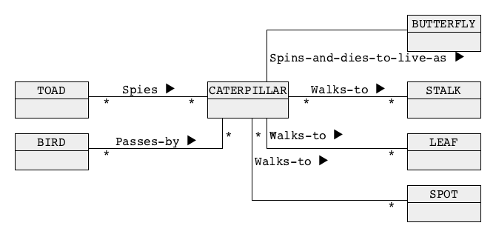
Example 4
Step 2: Creating associations and association classes
Brown and furry Caterpillar in a hurry Take your walk To the shady leaf, or stalk, Or what not, Which may be the chosen spot. No toad spy you, Hovering bird of prey pass by you; Spin and die, To live again a butterfly.
34
Notes:
<!-- Neural, Brian, Male, British English. -->
<speak>
<break time="0.5s"/>
<prosody rate="90%">
In the next step, we read a specification again, to find the associations and association classes.
<break time="0.3s"/>
Pretty large number of classes of objects are linked with the following associations.
<break time="0.3s"/>
Toad spies caterpillar.
<break time="0.3s"/>
Bird passes caterpillar.
<break time="0.3s"/>
Caterpillar walks to leaf.
<break time="0.3s"/>
Caterpillar walks to spot.
<break time="0.3s"/>
Caterpillar walks to stalk.
<break time="0.3s"/>
Caterpillar spins and dies to live as butterfly.
<break time="0.3s"/>
The multiplicities of all associations, except one, are many to many.
<break time="0.3s"/>
An association: Caterpillar spins and dies to live as butterfly, has multiplicities one to one.
<break time="0.3s"/>
This is, because in a process of metamorphosis, one caterpillar is transformed into one butterfly, and one butterfly arises from one caterpillar.
<break time="0.3s"/>
Three repetitions of an association: walks, suggest generalisation of the classes leaf, spot, and stalk.
<break time="0.3s"/>
We shall do it later on.
<break time="0.5s"/>
</prosody>
</speak>
Systems Analysis
34

Slide 35
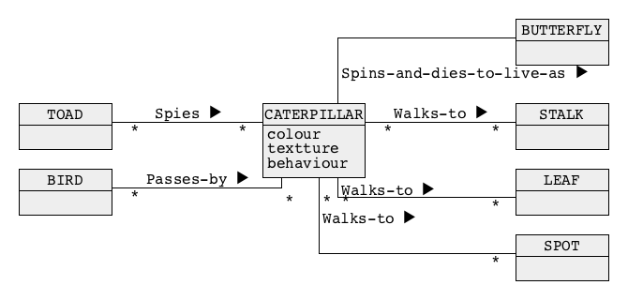
Example 4
Step 3: Creating attributes and link attributes
Brown and furry Caterpillar in a hurry Take your walk To the shady leaf, or stalk, Or what not, Which may be the chosen spot. No toad spy you, Hovering bird of prey pass by you; Spin and die, To live again a butterfly
35
Notes:
<!-- Neural, Brian, Male, British English. -->
<speak>
<break time="0.5s"/>
<prosody rate="90%">
Next, we search for the attributes, and link attributes.
<break time="0.3s"/>
A caterpillar is brown and furry.
<break time="0.3s"/>
This is information about a colour, and texture of a caterpillar.
<break time="0.3s"/>
Other caterpillars can also be described by the colour and texture.
<break time="0.3s"/>
A fact, that the caterpillar is in a hurry contributes to an attribute: behaviour.
<break time="0.3s"/>
No link attributes can be found.
<break time="0.5s"/>
</prosody>
</speak>
Systems Analysis
35

Slide 36
Example 4
Step 4: Creating identifiers
Brown and furry Caterpillar in a hurry Take your walk To the shady leaf, or stalk, Or what not, Which may be the chosen spot. No toad spy you, Hovering bird of prey pass by you; Spin and die, To live again a butterfly.
36
Notes:
<!-- Neural, Brian, Male, British English. -->
<speak>
<break time="0.5s"/>
<prosody rate="90%">
Next, we search for the identifiers.
<break time="0.3s"/>
A poem, does not say anything about any specific caterpillar, or bird, or toad.
<break time="0.3s"/>
Hence, we conclude, that a specification does not provide any information about the identifiers.
<break time="0.5s"/>
</prosody>
</speak>
Systems Analysis
36

Slide 37
Example 4
Step 5: Creating qualifications
Brown and furry Caterpillar in a hurry Take your walk To the shady leaf, or stalk, Or what not, Which may be the chosen spot. No toad spy you, Hovering bird of prey pass by you; Spin and die, To live again a butterfly.
37
Notes:
<!-- Neural, Brian, Male, British English. -->
<speak>
<break time="0.5s"/>
<prosody rate="90%">
Next, we look for the qualifications.
<break time="0.3s"/>
We read the specifications again, and we find no information, that may contribute to qualification of the classes of objects and associations with the attributes.
<break time="0.3s"/>
</prosody>
</speak>
Systems Analysis
37

Slide 38
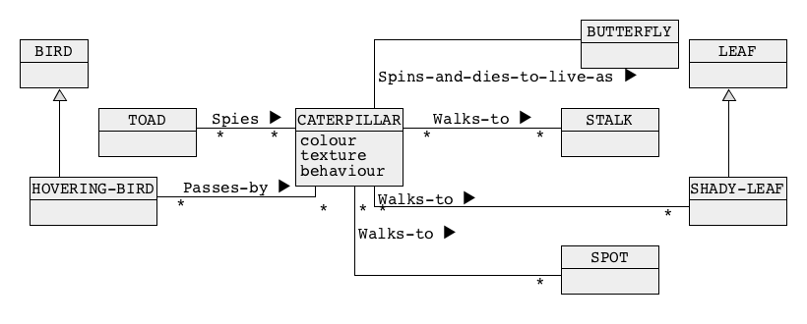
Example 4
Step 6: Creating generalisations
Brown and furry Caterpillar in a hurry Take your walk To the shady leaf, or stalk, Or what not, Which may be the chosen spot. No toad spy you, Hovering bird of prey pass by you; Spin and die, To live again a butterfly.
38
Notes:
<!-- Neural, Brian, Male, British English. -->
<speak>
<break time="0.5s"/>
<prosody rate="90%">
Finally, we try to find the generalisations.
<break time="0.3s"/>
A shady leaf can be generalised into a leaf.
<break time="0.3s"/>
Then, a stalk, a spot, and leaf can be generalised to, a location.
<break time="0.3s"/>
Such generalisations, allow us to replace three associations: caterpillar walks to, with one association: caterpillar walks to location.
<break time="0.5s"/>
</prosody>
</speak>
Systems Analysis
38

Slide 39
References
C. Coronel, S. Morris, A. Basta, M. Zgola, Data Management and Security, Chapters 3 and 4, Cengage Compose eBook, 2018, eBook: Data Management and Security, 1st Edition
T. Connoly, C. Begg, Database Systems, A Practical Approach to Design, Implementation, and Management, Chapter 16 Methodology – Conceptual Database Design, Pearson Education Ltd, 201
39
Notes:
<!-- Neural, Brian, Male, British English. -->
<speak>
<break time="0.5s"/>
<prosody rate="90%">
References.
<break time="0.5s"/>
</prosody>
</speak>
Systems Analysis
39

